Slide 1
Module 17

Slide 2
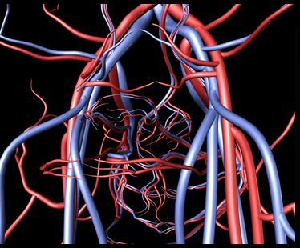
A pumping organ is needed to push the blood around the body along with a network of tubes to reach all the tissues
Network of
tubes
The Blood vessels

Slide 3
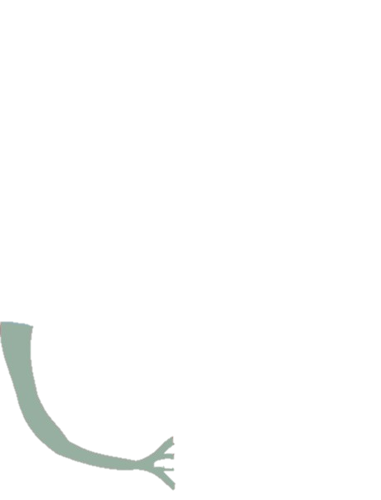
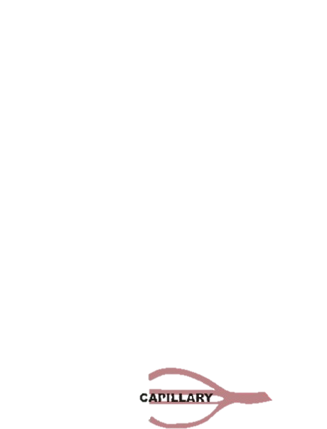


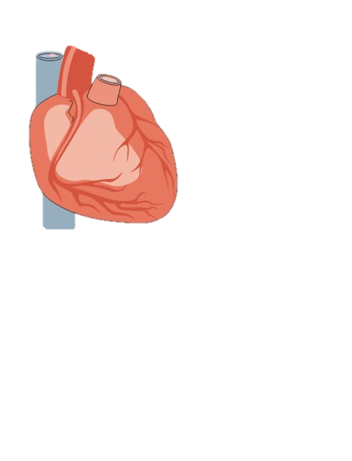

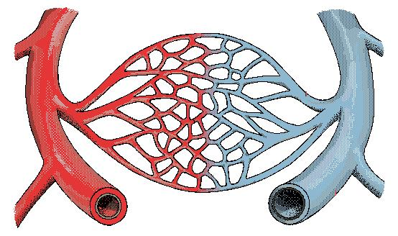
The aorta divides to form arteries.
Artery
Heart
On reaching the tissues, the arteries divide and redivide into smaller vessels called capillaries.
O₂
Vein
CO₂
Exchange of materials takes place between the blood and the surrounding cells across the thin walls of the capillaries.
The capillaries join together to form veins which take the blood away from the organ towards the heart.

Slide 4
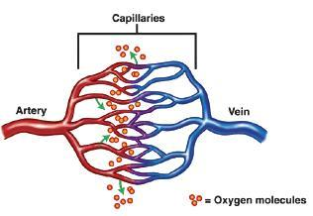
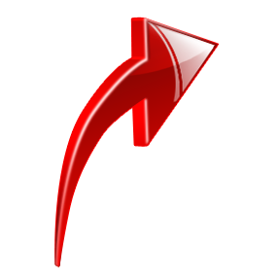
The Blood vessels
Arteries
Veins
Carries blood away from heart.
Brings back blood to the heart.
Have to tolerate high pressure.
Do not tolerate high pressure.
Thick and elastic walls.
Not thick walled, have valves to prevent back flow of blood.

Slide 5
ARTERIES | VEINS
Blood – from heart to different parts | Blood – from different parts to heart
Blood is under high pressure | Blood is not under high pressure
Thick and elastic walls | Thin wall and less elastic
Valves are absent | Valves are present to prevent back flow
Carry oxygenated blood except pulmonary artery | Carry deoxygenated blood except pulmonary veins
Pure (O₂)
Impure (CO₂)

Slide 6
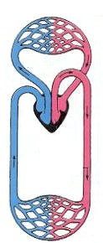
Lung capillaries
Double Circulation
Pulmonary veins from lungs
Network of capillaries
Aorta to body
Capillaries in the body part from the lungs
..Diagrams

Slide 7
Thank You

